Slide 1


Integrated Geophysical Analysis of the Needville and Hockley Faults
Kevin Schmidt
5/16/2013
University of Houston

Slide 2

Summary
Hundreds of active faults have been identified in the Houston area
Detailed subsurface study to identify faults geometry/distribution, physical properties and potential hazards
  Needville
    Gravity/GPS
    2D GPR
    Seismic
  Hockley
    GRAVITY/GPS
    2D GPR
    2D SEISMIC

Slide 3
Gravity

Slide 4
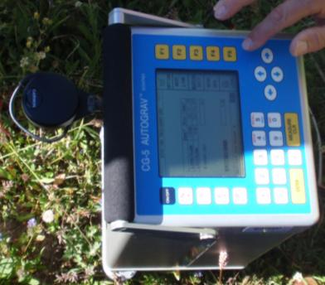
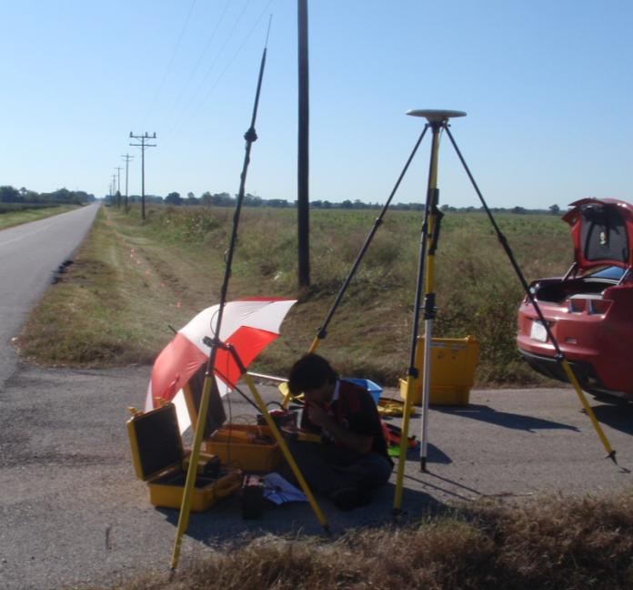
Gravity

Slide 5
Gravity
SE NW

Slide 6
GPR

Slide 7
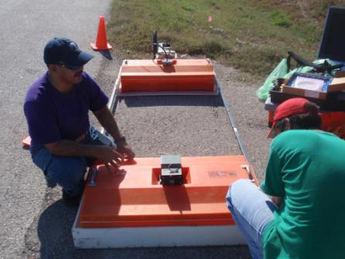
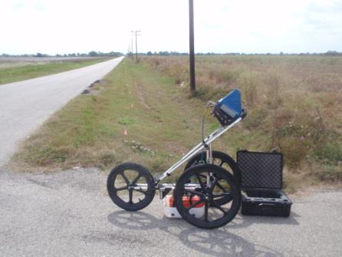
Equipment
100 MHz monostatic, Bistatic High range, 1.5 meter offset
GSSI Noggin System- 400 MHz, monostatic
Notes:
GPR will be conducted perpendicular to a fault to image the faults in subsurface. The GPR will help to connect the surface image of the fault produced through the LiDAR processing and the subsurface image of the faults found through the seismic processing

Slide 8
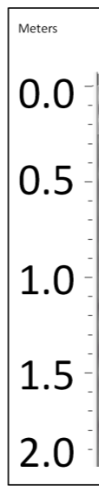
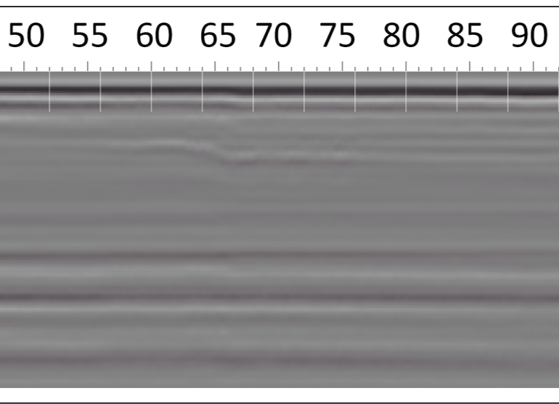
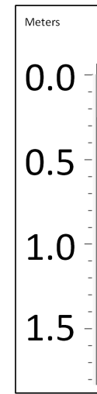
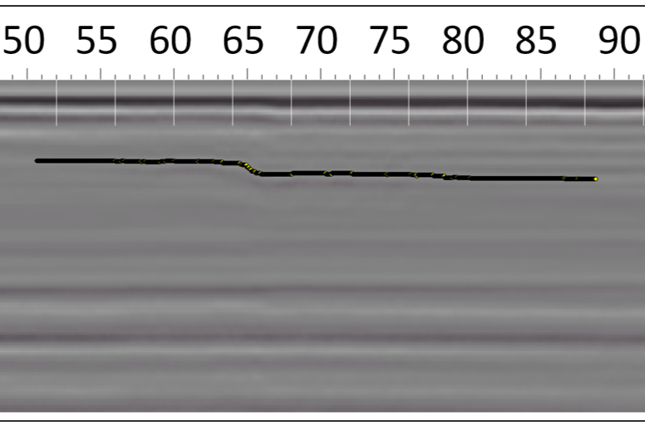
GPR

Slide 9
Seismic

Slide 10
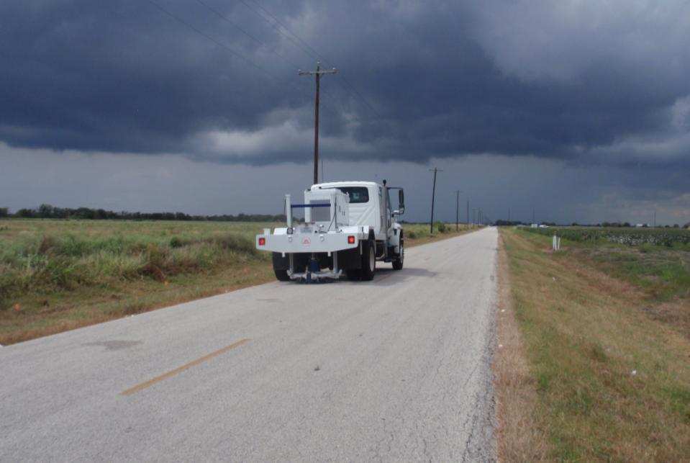
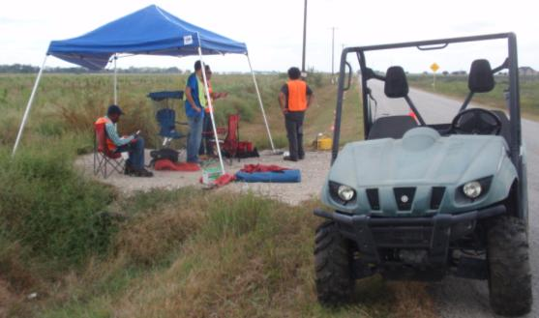
Seismic

Slide 11
Schematic
Geophones 2-23
Geophones 25-48
Geophones 49-72
Geophones 73-96
Geophones 97-120
Geophones 121-144
Geophones 145-168
Geophones 169-192
Geode 1
Geode 2
Geode 3
Geode 4
Geode 5
Geode 6
Geode 7
Geode 8
Battery
Battery
Battery
Battery
Battery
Battery
Battery
Battery
NIB
Computer
RTS 100
Battery
Vibe Truck
Antenna
Notes:
Acquire and process seismic data in order to map the faults at depth

Slide 12
Seismic
SE NW

Slide 13
Seismic
SE NW

Slide 14
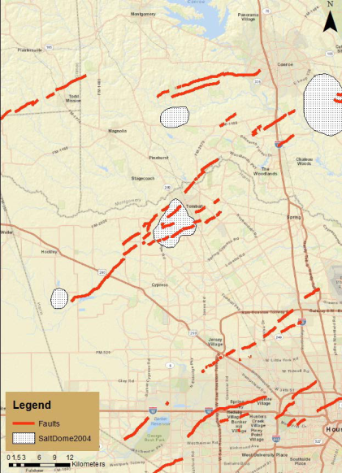
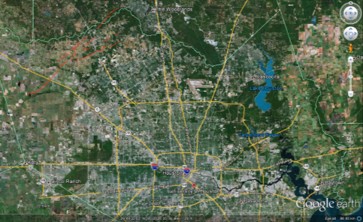
Study Area
Hockley fault
XU HAN,2012

Slide 15
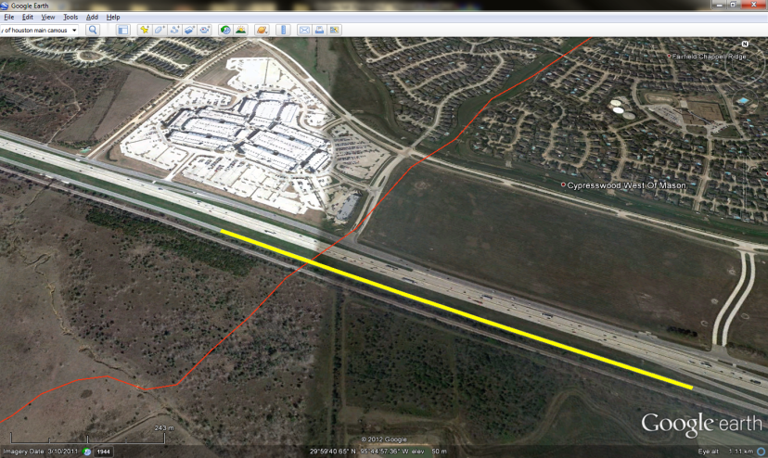
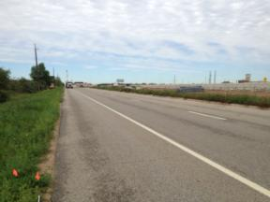
Seismic Survey
Premium Outlet
Hockley fault
dipping
Block out due to highway construction
1075m
325m+750m

Slide 16
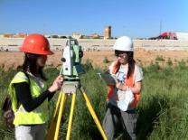
Total Station Survey vs GPS Survey
Elevation change(m)
Elevation change(m)

Slide 17
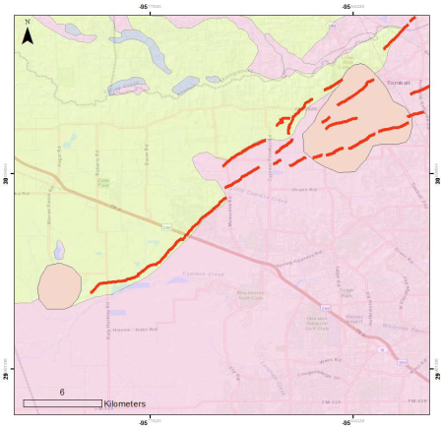
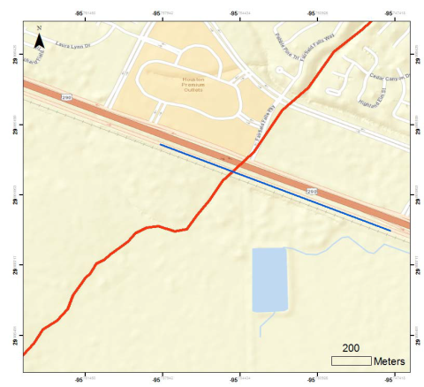
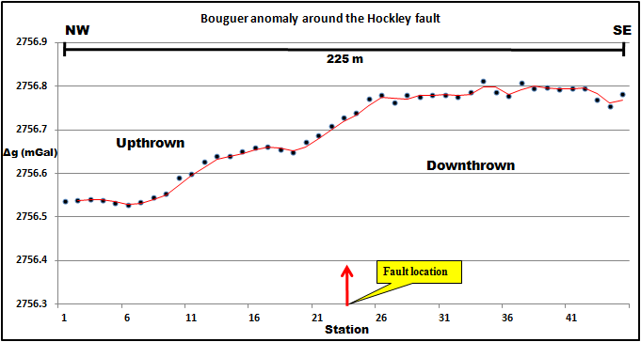
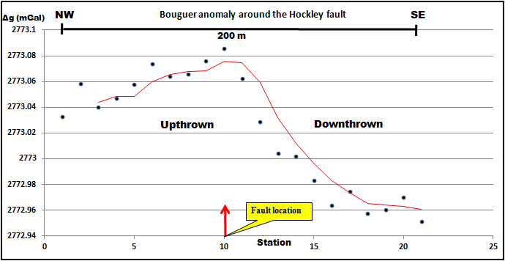
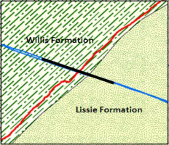
Gravity Survey
Willis Formation
Lissie Formation
Xu Han, 2012
Xu Han, 2012

Slide 18
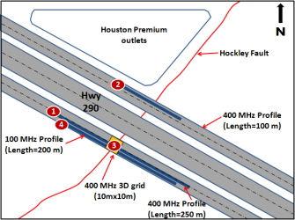
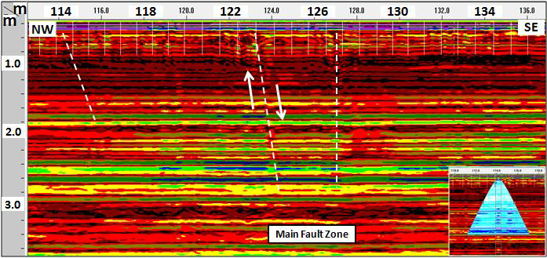
GPR Survey
Otoum,2011

Slide 19
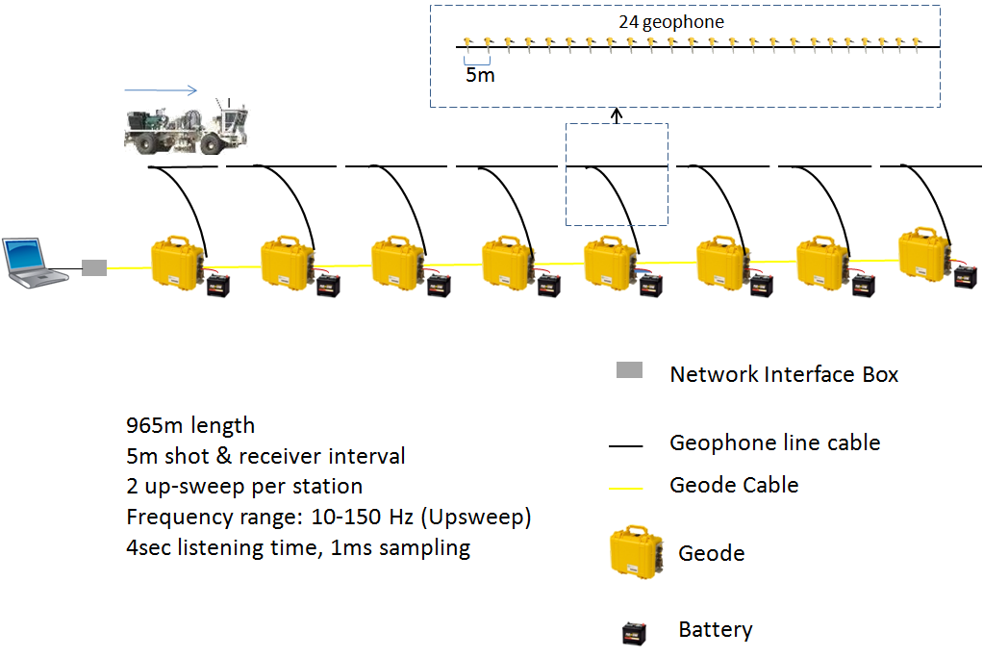
Seismic Line Lay Out
Field parameters
Line length : 1075m
# of Receiver: 216
Shot interval : 5m, Receiver interval : 5m
Sample rate : 1ms
Record length : 4sec
Vertical Stack :2
Sweep length: 12sec
Sweep type : Linear sweep
10Hz→150Hz

Slide 20
Processing Flow
GEOMETRY CORRECTION
BP FILTER
DECON
F-K FILTER
VELOCITY
STACK
FX-DECON
MIGRATE
NOISE ATTENUATION

Slide 21
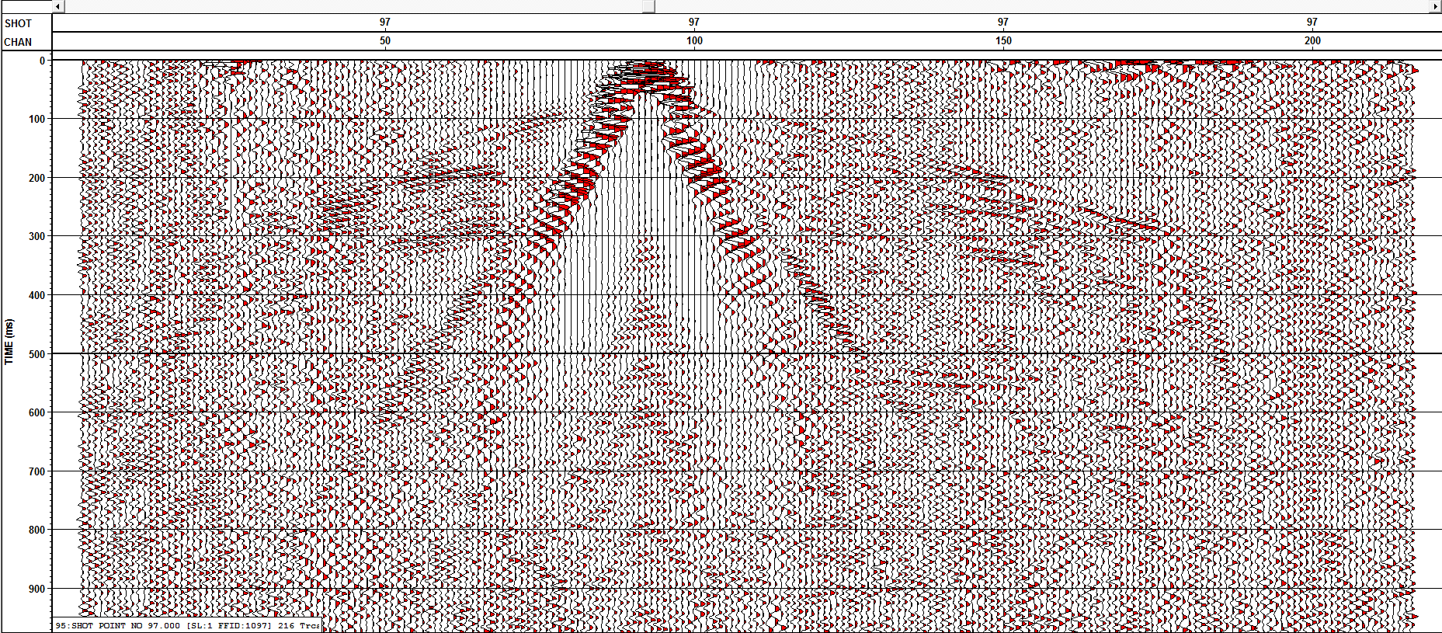
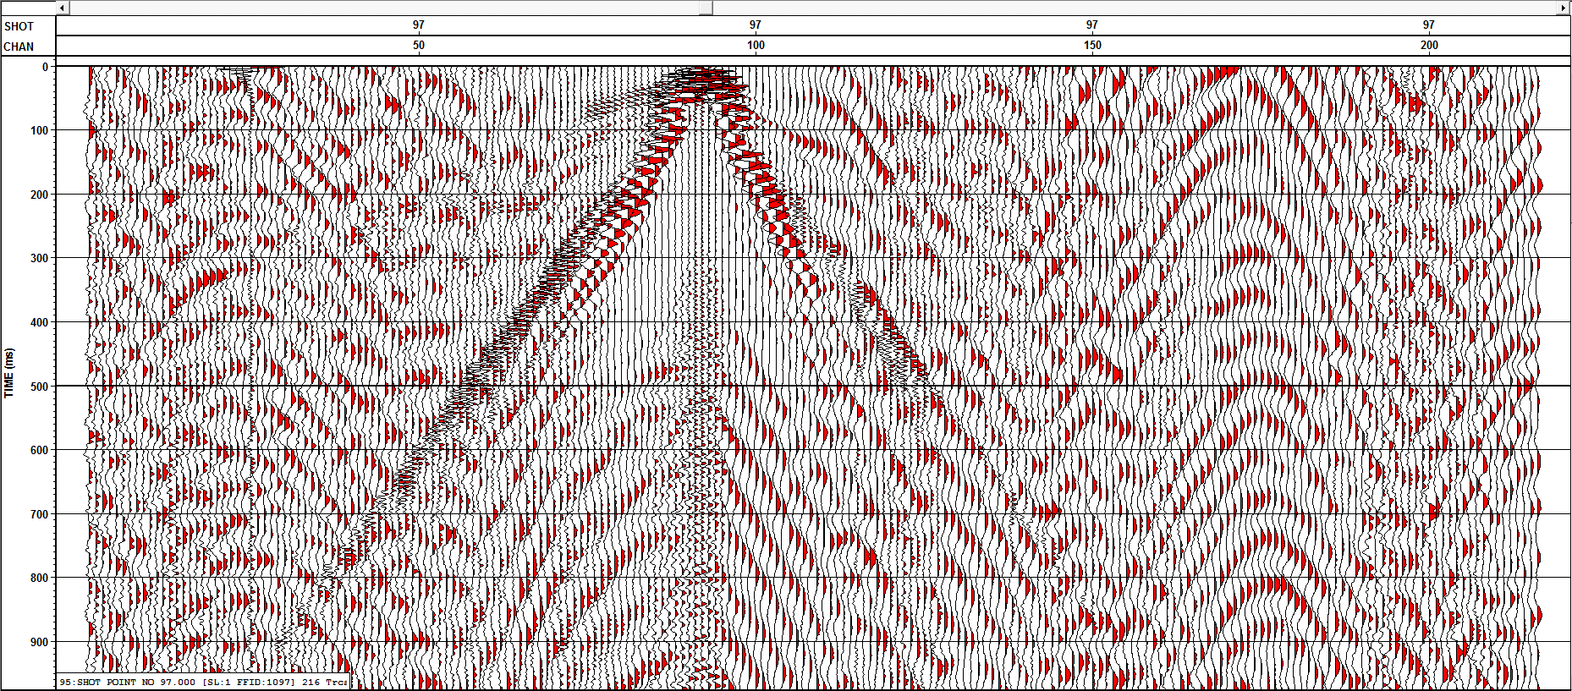
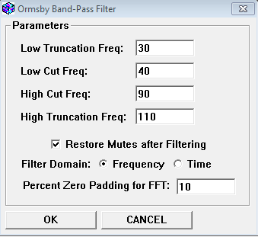
Filter
Low frequency noise due to field crew, atv, construction truck
High Frequency Noise due to Highway
Hard to image deeper than 1 sec
Decision made to focus on 0-1 sec by cutting low and high frequencies

Slide 22
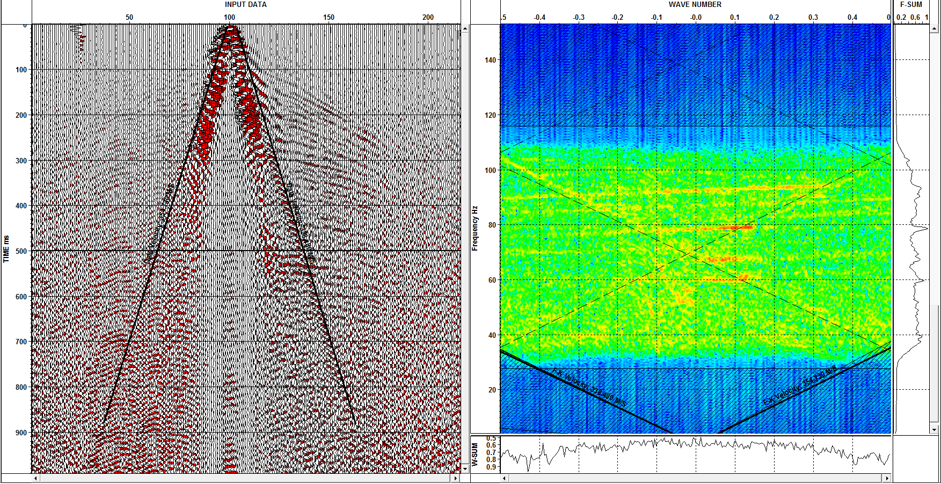
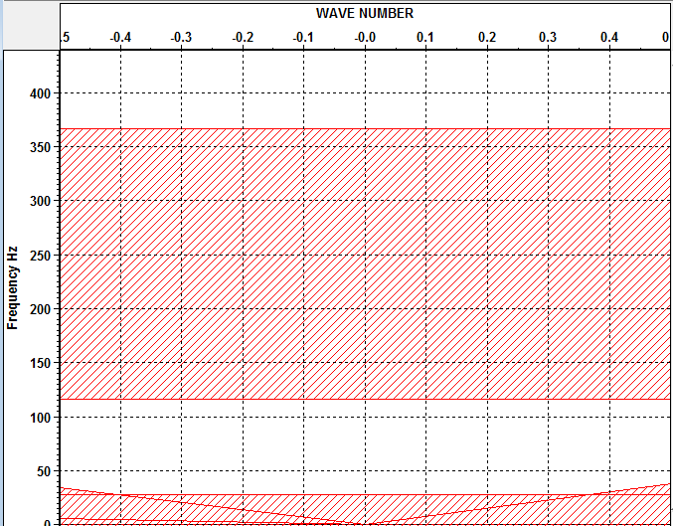
Filter

Slide 23
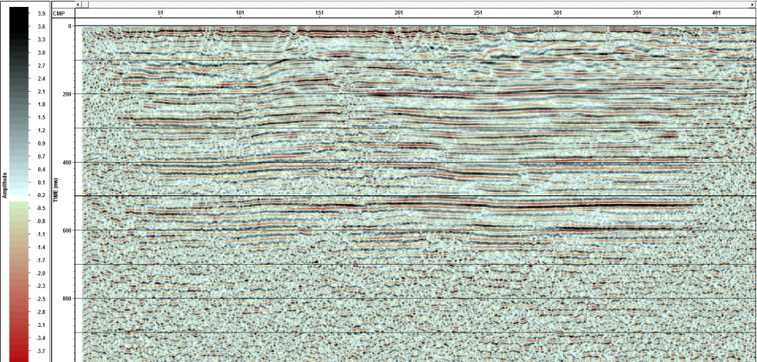
Stack

Slide 24
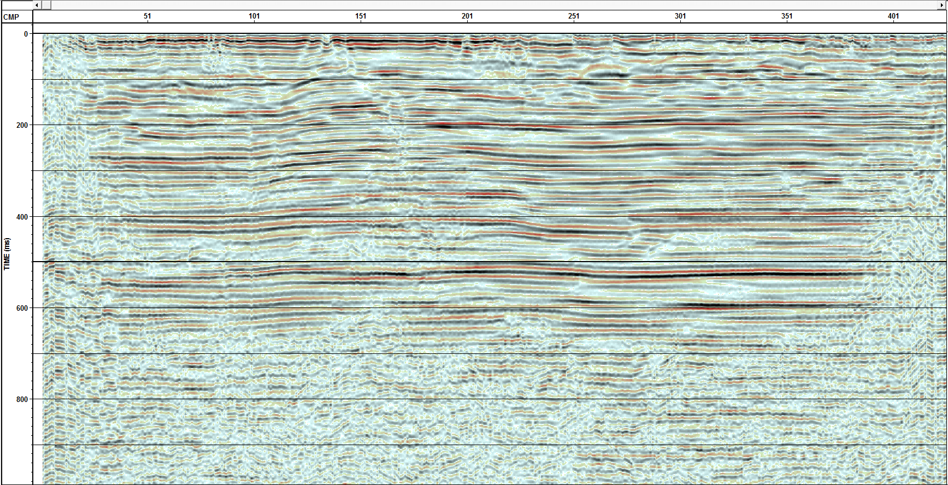
Noise Filter

Slide 25
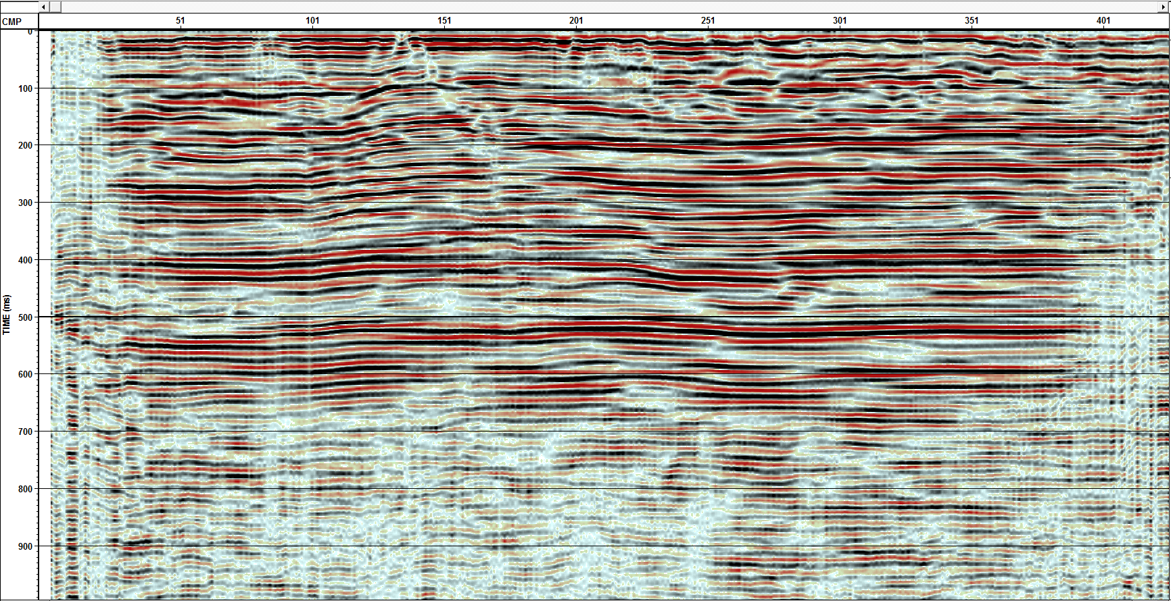
Time Migration
Fx Decon + Noise Attenuation

Slide 26
Time Migration
Fx Decon + Noise Attenuation

Slide 27

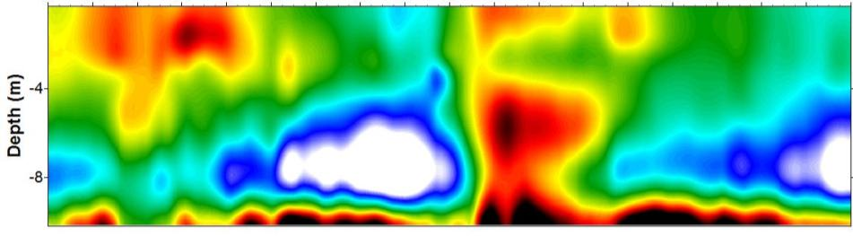
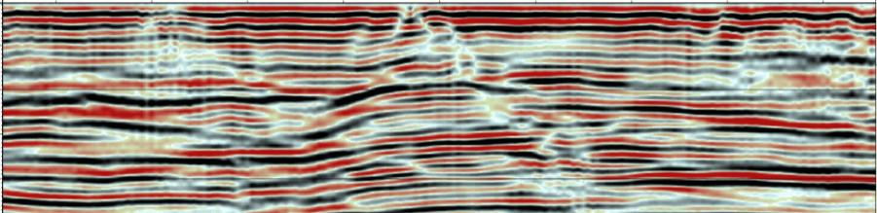
S-Wave Structure
200
275
325
SE
Distance (m)
S-wave Velocity (m/s)
120
170
220
270
320
370
420
470
520
570
50
100
Time(ms)
150
200

Slide 28

Thank you!

